Slide 1



There is a replication crisis, but low replicability of published findings is good for science
Stephan Lewandowsky
School of Experimental Psychology and Cabot Institute University of Western Australia
Klaus Oberauer
August 2018—ongoing record of replication market simulations
@STWorg

Slide 2
Replicability is fundamental to science
“A finding needs to be repeatable to count as a scientific discovery” (Zwaan et al., 2017)
Replicability is a line of demarcation that separates science from pseudoscience (Dunlap, 1926)
It just sucks if a finding doesn’t replicate

Slide 3
Why is there a ‘Replication Crisis’?
Researcher degrees of freedom
Questionable research practices (QRPs)
underpowered studies (Button et al., 2013)
p-hacking (Jennison & Turnbull, 1990)
HARKing (Kerr, 1998)
publication bias (Ferguson & Heene, 2012)
Notes:
Low power problem: PPV (positive predictive value) depends on priors and power. PPV= power X prior odds / (power x prior odds + alpha)

Slide 4
Replicability of flawless research
Psychological phenomena are inherently stochastic
How do we best manage the inevitability of some findings not replicating?

Slide 5
For science, low replicability may be good

Slide 6
For science, low replicability may be good
Whether or not findings are considered interesting or meaningful has nothing to do with their replicability
What matters is what science overall achieves
Reframe Replication Crisis as Replication Market
Low replicability of published studies may optimize market outcome

Slide 7
Whether or not findings matter has nothing to do with their replicability
Researchers want their papers to be important (i.e., considered interesting and meaningful)
Highly-cited papers are, by definition, considered interesting and meaningful
You may not like that …
… but actually: no one cares about zero-citation papers (even if they are yours or mine)
Researchers want citations …
… but do they get them?

Slide 8
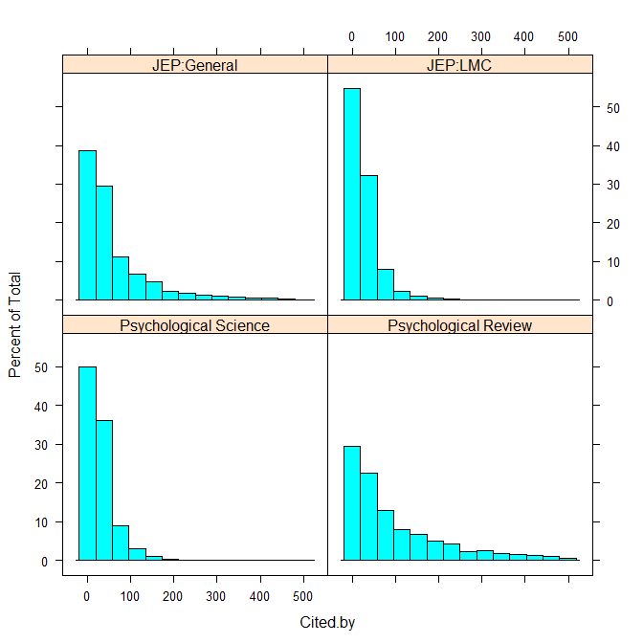
Whether or not findings matter has nothing to do with their replicability
Last 2,000 articles published in each journal (Scopus, April 2018)
Percent total
Nobody submits a paper thinking “great, that’ll be a zero-citation dud”
The market place of ideas cannot be predicted
Number of citations per paper
Notes:
http://geekpsychologist.com/how-many-citations-does-a-typical-research-paper-in-psychology-receive/
Among all 48,000 papers, 25% received fewer than 6 citations, and 75% received fewer than 27 citations. The median research paper in psychology received 12 citations.

Slide 9
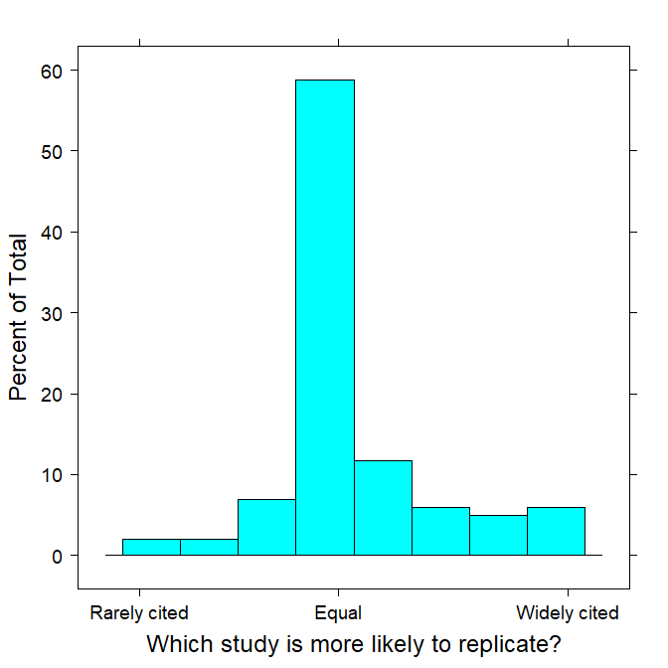
Citations and replicability
Survey of N ≈ 100 expert attendees of Psychonomics symposium on replicability (Amsterdam, 2018)

Slide 10
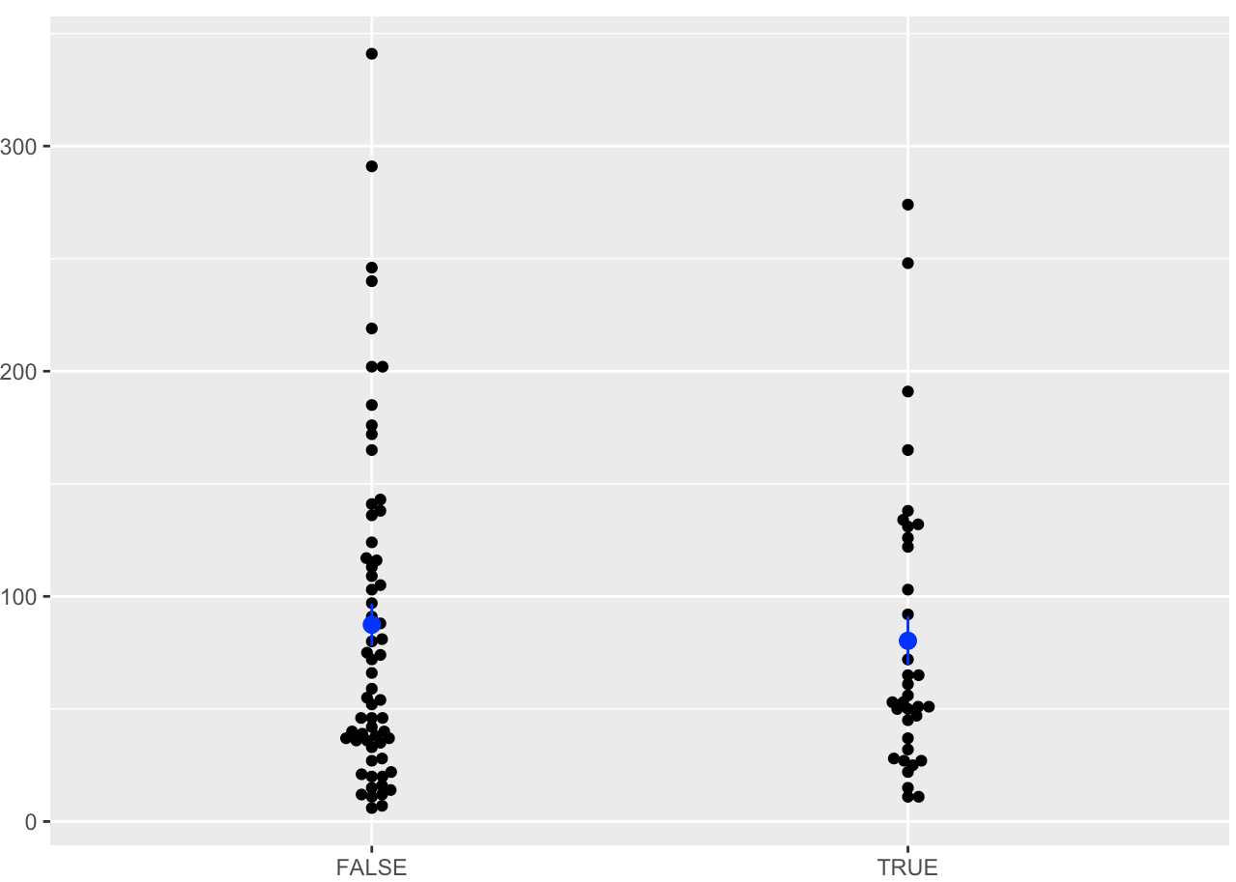
Citations and replicability
Citations of 100 studies in Reproducibility Project (by Ruben Arslan)
Citation count
No effect
Did study replicate?

Slide 11
What matters is what science overall achieves
Failures to replicate carry a cost
wasted experiments
Replicated studies no one cares about also carry a cost
wasted experiments
How do we minimize cost to maximize discovery of interesting new knowledge?

Slide 12
To minimize overall cost, optimize a market of ideas and replications
An intuitive example
Assume:
Replicability = 1/3
Finding considered interesting = 1/10
Optimize:
Cost measured in number of experiments needed for 1 interesting replicable finding

Slide 13
Replicate before publishing
Published Unpublished
1 interesting finding = 60 experiments

Slide 14
Publish before replicating
Published
1 interesting finding = 33 experiments

Slide 15
Simulation of replication market
“Real world”
100 possible phenomena (10 levels of independent variable × 10 potential dependent variables)
9% of those phenomena exist (Dreber et al., 2015)
91% of those phenomena do not exist
Scientific community
seeks to maximize identification of interesting phenomena
replication decisions are based on presumed interest
Output measures (community at large)
number of phenomena discovered
number of experiments conducted

Slide 16
“Real World”
H₀ true
H₁ true
(i.e., differs from control)
0 | 0 | …
 |  | 1
Randomly chosen with P(effect)=.09
Dependent variable
Independent variable

Slide 17
Each simulated experiment
Randomly choose independent & dependent variables
IV from {1, 2, … 10}
DV from {1, 2, … 10}
Run an experiment
n = 30, µ = 0|1, σ = 2
α = .05
Power ≈ .8
Option to p-hack
5 additional batches of subjects
n_{batch} ∈ {1, 5, 10}

Slide 18
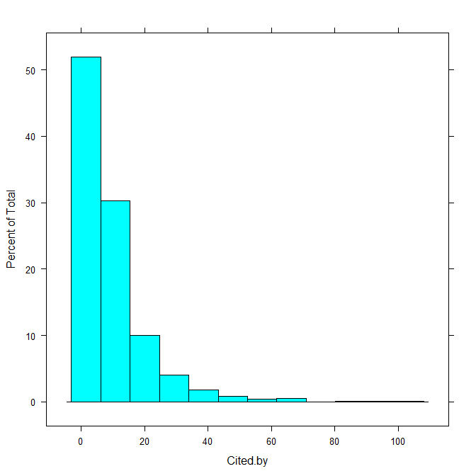
Determine interest in effect
1
2,000 articles published in 2014 in all of psychology (Scopus, April 2018)
Percent total
Number of citations per paper

Slide 19
Determine interest in effect
2
Fit generalized Pareto
Proportion total
90th percentile is interest threshold
Number of citations per paper

Slide 20
Determine interest in effect
3
Logistic decision bound centered on 90th percentile, with steepness determined by gain ∈{1, 5, 10}
P(interest)
Number of citations per paper

Slide 21
Replication decisions I: Private
Conduct 100 studies Replicate Publish successful
any p < .05 replications
1
2
..
..
100
p < .05
p < .05
p < .05
Published
Fail to replicate
Apply probabilistic decision to count replicated results deemed “interesting”

Slide 22
Replication decisions I: Private
Conduct 100 studies Replicate Publish successful
any p < .05 replications
1
2
..
..
100
p < .05
p < .05
p < .05
Published
Fail to replicate
Apply probabilistic decision to count “interesting”
replicated results

Slide 23
Replication decisions I: Public
Conduct 100 studies Publish Apply probabilistic any p < .05 decision to replicate
1
2
..
..
100
p < .05
p < .05
Published
Published
Replicated
Count replicated results deemed to be “interesting”

Slide 24
Design of simulation experiment
p-hacking
no p-hacking
add {1, 5, 10} participants in up to 5 batches if effect not significant
all experiments conducted identically
Gain (g) of logistic decision
1, 5, 10
Conduct ≥ 1,000 simulations in each cell
each with unique random “real world” explored by 100 experiments (+ replications)
count replicated effects of interest (new knowledge)
count total number of experiments (cost)

Slide 25
For each cell, do this ≥ 1,000 times
0 | 0 | …
 |  | 1
z>2?
z>2?
Variable 1
Replicate?
z>2?
z>2?
z>2?
Conduct 100 random experiments
Variable 2

Slide 26
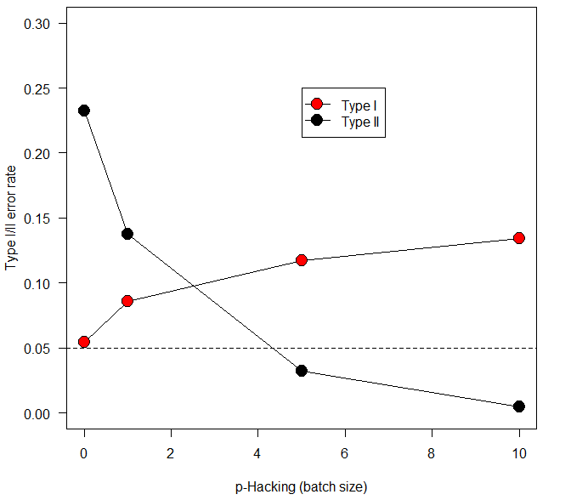
Simulation results: p-hacking

Slide 27
Simulation results: p-hacking
Power ≈ .8
α =.05
No p-hacking, stop after n=30

Slide 28
Simulation results: p-hacking
Add this many participants up to 5 times, or until p < .05

Slide 29
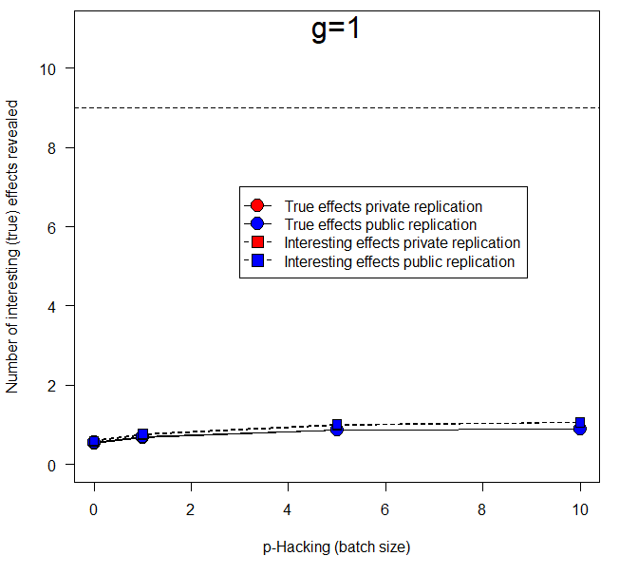
Simulation results: Accumulation of knowledge
Steep decision slope (virtual threshold at 90th %ile)
Maximum achievable knowledge

Slide 30
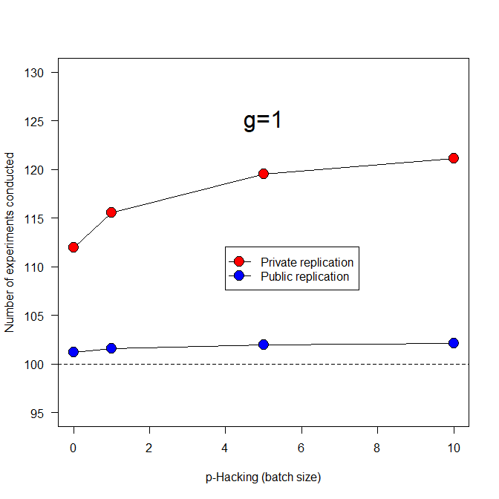
Simulation results: Cost of new knowledge
Added cost of insisting that people publish replicated (i.e., replicable) results
Minimum n of experiments (before replications)

Slide 31
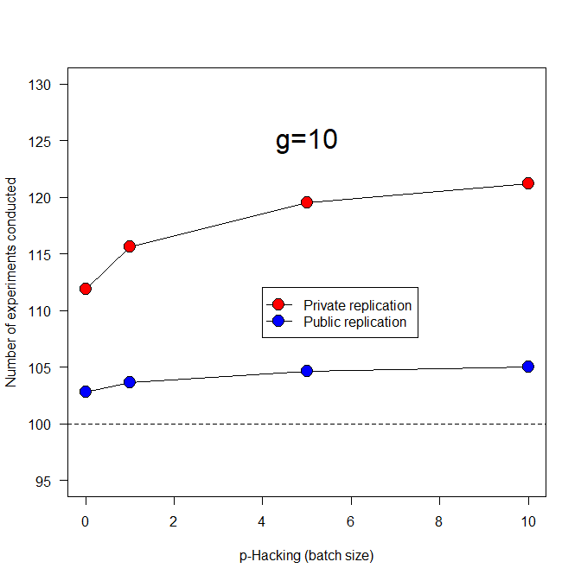
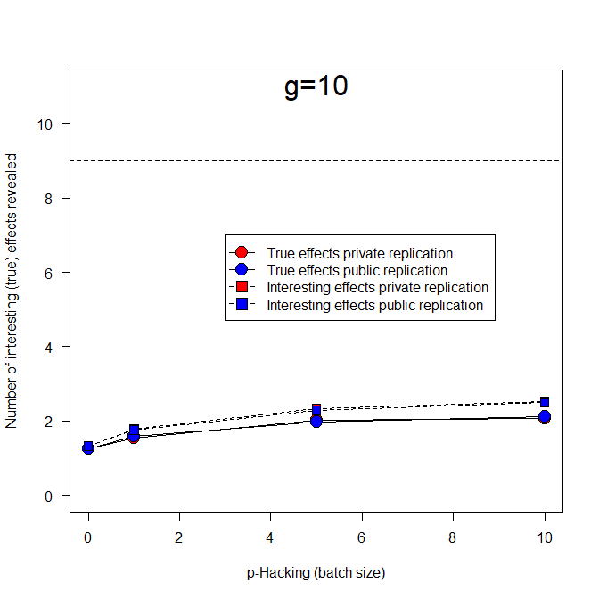
Simulation results: More graded interest (g=10)
Cost of knowledge New knowledge
Slightly more experiments overall
Double the number of discoveries compared to g=1

Slide 32
Simulation results: More graded interest (g=10)
Cost of knowledge New knowledge
p-hacking introduces slightly more spurious effects
Slightly more experiments overall
p-hacking increases number of true effects found

Slide 33
Taking it to an extreme: Everything is significant (faking it*)
* Replications are honest and there are true effects (Stapel did not alter nature)

Slide 34
Taking it to an extreme: Everything is significant (faking it*)
Cost of knowledge (g=1) Cost of knowledge (g=10)
* Replications are honest and there are true effects (Stapel did not alter nature)

Slide 35
Taking it to an extreme: Everything is significant (faking it)
Knowledge discovered (g=1) Knowledge discovered (g=10)

Slide 36
The effects of fraud:
Many additional experiments
Fake (g=10)
Many more
false interesting effects
Genuine (g=10)

Slide 37
Taking it to another extreme: Nothing really exists (“Bemscape”)
g=10

Slide 38
Bayesian t-test (Jeffrey-Zellner-Siow prior [JZS], Cauchy distribution on effect size)
Note: σ = 2 for comparability with frequentist simulations
Bayesian t-test has far less power and lower Type I error rate (BF > 3 ≈ p < .05)
Notes:
http://pcl.missouri.edu/bf-one-sample for online calculator, https://figshare.com/articles/Bayes_Factors_Matlab_functions/1357917 for code downloaded

Slide 39
Bayesian t-test: BF10 only (not BF01 because exploratory research rarely seeks null effects)
(Gain = 1)
(Gain = 1)
Notes:
Based on BF=3 cutoff and Nrep=1,000.

Slide 40
Bayesian t-test: BF10 only (not BF01)
Unlike frequentist t, no effect of p-hacking but also fewer effects discovered
(Gain = 10)
(Gain = 10)

Slide 41
Bayesian t-test: Increase power (Jeffrey-Zellner-Siow prior [JZS], Cauchy distribution on effect size)
Note: σ = 1 to increase power
Notes:
http://pcl.missouri.edu/bf-one-sample for online calculator, https://figshare.com/articles/Bayes_Factors_Matlab_functions/1357917 for code downloaded

Slide 42
Bayesian t-test: BF10 only (not BF01)
(Gain = 1)
(Gain = 1)
Notes:
Based on BF=3 cutoff and Nrep=1,000.

Slide 43
Bayesian t-test: BF10 only (not BF01)
Bayesian t-test on par with frequentist t when σ cut in half
(Gain = 10)
(Gain = 10)

Slide 44
Now add theory: I. World has structure
H₀ true
H₁ true
(i.e., differs from control)
0 | 0 | …
 |  | 1
 |  |  |  | C
Randomly chosen centroid location
Dependent variable
True effects cluster around centroid
Independent variable

Slide 45
Now add theory: II. Theory captures structure to varying extents
Experiments search space near theory centroid
0 | 0 | …
 |  | 1 |  |  | T
 |  |  |  | C
 |  |  |  |  |  |  | T
 | T
Nearly perfect theory (ρ ≈ 1) shares centroid location with true structure (or nearly so)
Dependent variable
Modestly good theory (ρ ≈ 0.5)
Poor theory (ρ ≈ 0)
Independent variable

Slide 46
Examples of worlds and theories: A perfect theory (ρ=1)
A
B
True effects
Identical centroids
Randomly chosen replications
Experimental variables

Slide 47
A reasonable theory and the world (ρ=0.5)
A
B
True effects
Randomly chosen replications
Experimental variables

Slide 48
A poor theory (ρ=0.1): World vs. experiments
A
B
True effects
Randomly chosen replications
Experimental variables

Slide 49
The “perfect” theory: centroids overlap, ρ=1 (Frequentist t-test)
Dashed line is expected number not actual

Slide 50
The “perfect” theory: centroids overlap
Experiments are run “with replacement”, so same true effect can be discovered more than once

Slide 51
A “reasonable” theory: ρ = 0.5
Dashed line=actual number of true effects

Slide 52
A “reasonable” theory: ρ = 0.5

Slide 53
A poor theory: ρ = .1
Dashed line=actual number of true effects

Slide 54
A poor theory: ρ = .1

Slide 55
Theories and Bayes
From here on, all results rely on Bayesian t-tests.
σ=2 for comparability with frequentist results.
As before, power with BF=3 is low

Slide 56
The “perfect” theory: centroids overlap, ρ=1 (Bayesian t-test)
Actual number of true effects: 7.60

Slide 57
The “perfect” theory: centroids overlap, ρ=1 (Bayesian t-test)

Slide 58
A “reasonable” theory: ρ = 0.5

Slide 59
A “reasonable” theory: ρ = 0.5

Slide 60
Considerations I: Positives
In a world of finite resources there is an opportunity cost to conducting unnecessary experiments
other, more fruitful lines of research are not pursued
Reducing resources required for publication particularly benefits junior researchers
Consonant with other calls for cost-benefit analyses of replications (Coles et al., 2018)

Slide 61
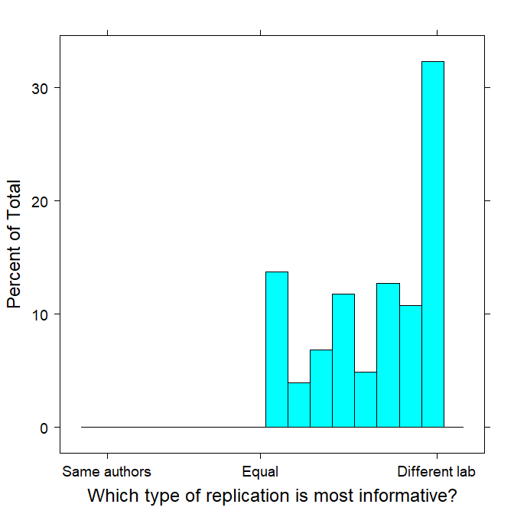
Considerations I: Positives
Experts (same survey as before) vastly prefer replications by other labs
Not a single expert believed that replications by same authors were preferable

Slide 62
Considerations II: Problems
Someone has to replicate (before Ted talk)
Replication failures are presently difficult to publish
Uninteresting unreplicated (but published) studies may still pollute
Who bears cost of (failed) replication of published study?
Who benefits from not having to replicate before publication?
Other costs not counted here (e.g., reviews)

Slide 63
Considerations II: Problems
Would public and media understand this market?
Published failures to replicate may not eradicate belief in original finding (cf. Greitemeyer, 2014; Lewandowsky et al., 2012)
Replication failures have political implications

Slide 64
Possible resolution: New way to publish
Begin with embargoed provisional publication
cannot be cited during embargo
no media coverage during embargo
invitation to replicate by others, who become co-authors
Provisional publication becomes archival after embargo
known that no one wanted to replicate it
Replicated publication replaces provisional with all replicators as authors and becomes version of record
Replication failure leads to withdrawal of provisional publication (acknowledging replicator)

Slide 65
Conclusions
Methodological soundness is essential
Methodological soundness alone cannot resolve replication crisis
False positives—and hence replication failures—will always exist
For science overall, knowledge accumulation is less costly if studies are published without being replicated
because the market place of ideas cannot be predicted
there is no point in replicating results before publication that are of no interest to the community

Slide 66
THE END

Slide 67
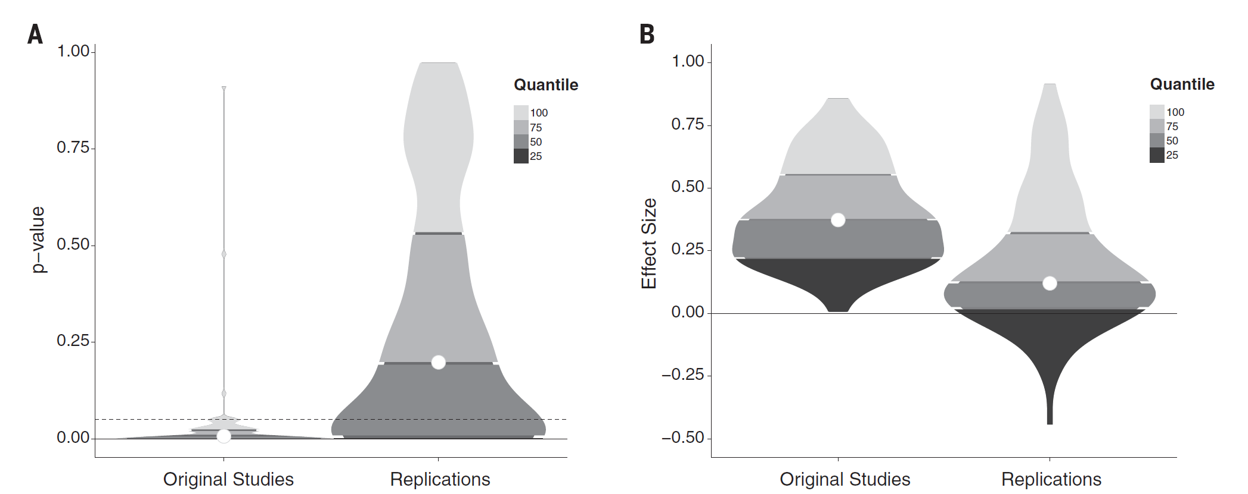
Estimating Replicability (Open Science Collaboration, 2015)
100 replications of published results in social and cognitive psychology
Social ≈ 25%
Cognitive ≈ 50%

